Slide 1
Background and Foreground Separation

Slide 2
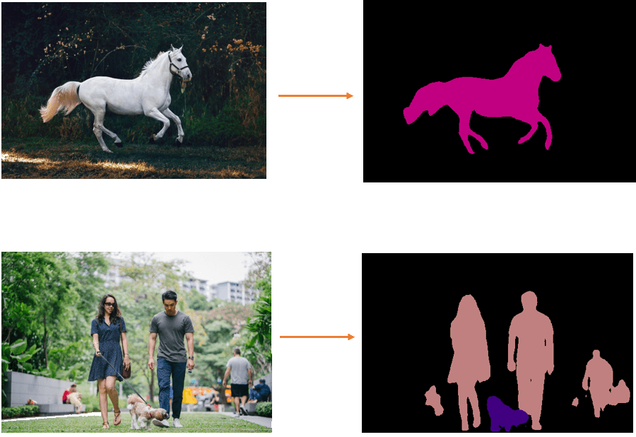
Foreground - Background Separation

Slide 3
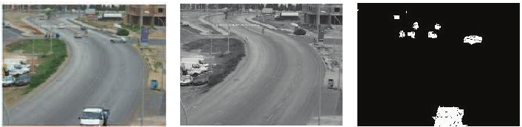
Foreground - Background Separation

Slide 4
Separation of Foreground and Background in an image
Background is a map of the sensory (visual) information encoded at much longer time constant, e.g., much slower changing.
In other words, objects that are static or sustained are encoded into the background.
Background image, B can be computed per pixel as:
α is in the range of [0, 1] and controls the time constant.
Larger the α faster the background adapts.
Generally one should start by setting α to a small number, like 0.001. In presence of high degree of change, or transients, α should be set to zero so that the background does not pick up the transients; otherwise α should gradually increase to 1 for speed up background learning.
B = (1 - α) B_{old} + α B_{new}

Slide 5
Separation of Foreground and Background in an image
Foreground is the transients components of a scene, defined as the difference between instantaneous image I and the background, B. The difference can be by simple subtraction:
or by color-space difference:
F = I - B
F_{r} = I_{r} - B_{r}
F_{g} = I_{g} - B_{g}
F_{b} = I_{b} - B_{b}
Both background and foreground computation described above can be applied to amplitude, color and depth images

Slide 6
Separation of Foreground and Background in an image
Foreground is the transients components of a scene, defined as the difference between instantaneous image I and the background, B. The difference can be by simple subtraction:
or by color-space difference:
F = I - B
F_{r} = I_{r} - B_{r}
F_{g} = I_{g} - B_{g}
F_{b} = I_{b} - B_{b}
Both background and foreground computation described above can be applied to amplitude, color and depth images.
Techniques : Color based segmentation, Depth based segmentation, Histogram, Semantic Segmentation
Deep Learning - mask region of interest and separate foreground from background.
Applications: Portrait Mode with Deep Learning
Background blur on video calls while working from home

Slide 7
Readings :
https://larrylisky.com/2017/06/23/separating-foreground-and-background-in-an-image/
https://medium.com/analytics-vidhya/application-of-foreground-and-background-separation-with-deep-learning-e5f47c60bce6
https://learnopencv.com/applications-of-foreground-background-separation-with-semantic-segmentation/
Semantic Segmentation
https://learnopencv.com/pytorch-for-beginners-semantic-segmentation-using-torchvision/

Slide 8
Readings :
Background Subtraction:
Temporal average filter:
Conventional Approaches
1. Frame Differences
2. The Mixture of Gaussians or MoG

Slide 9
Readings :
Background Subtraction:
Temporal average filter:
Conventional Approaches
1. Frame Differences
2. The Mixture of Gaussians or MoG

